Slide 1
EXCEL PROJECT VRINDA STORE DATA ANALYSIS REPORT Made By: Neelam Yadav

Slide 2
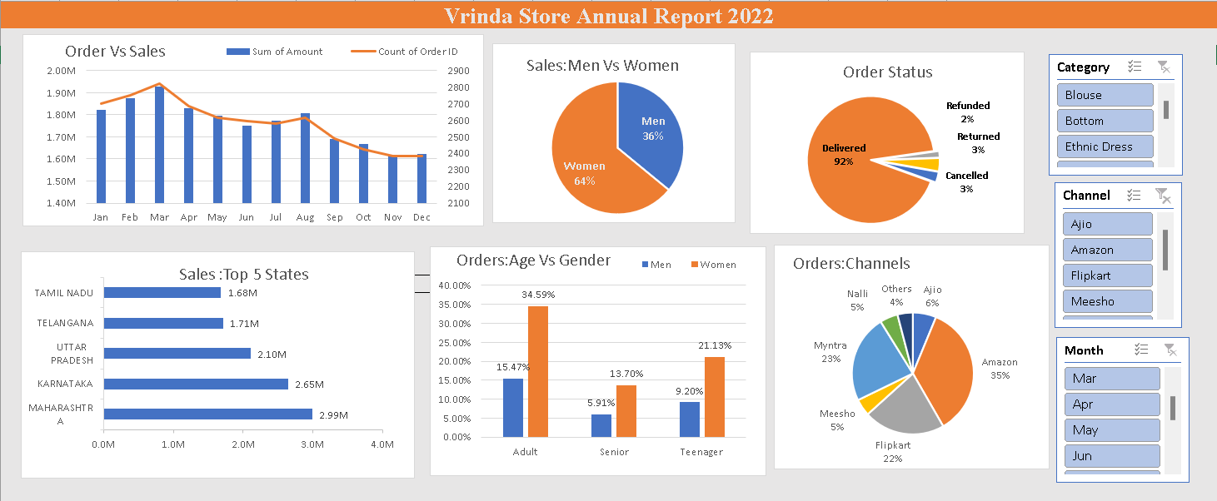

Slide 3
Project Objective
This project seeks to uncover actionable insights from sales and customer data to enhance business performance.By analyzing key trends ,identifying customer preferences,and optimizing marketing strategies ,we aim to drive sustainable growth and maximize revenue

Slide 4
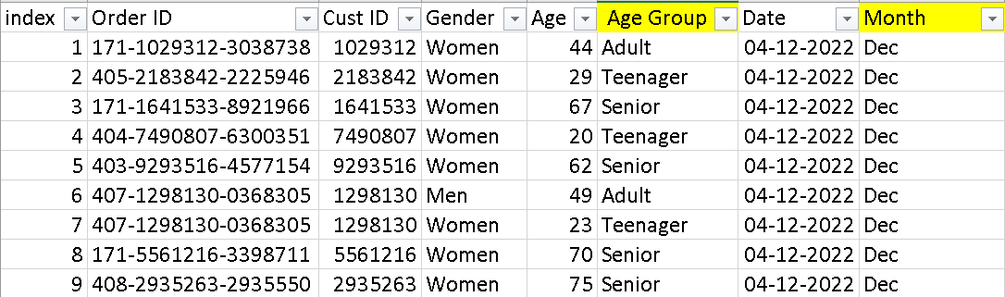
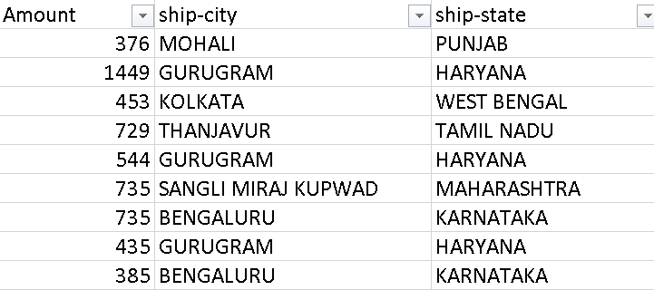
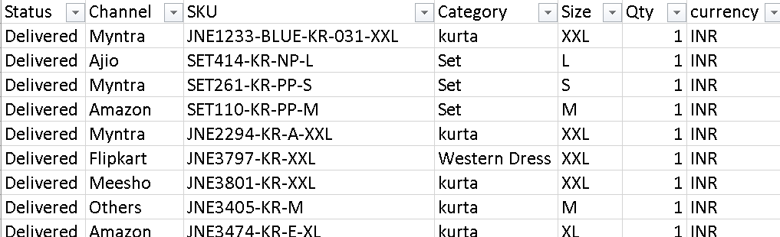
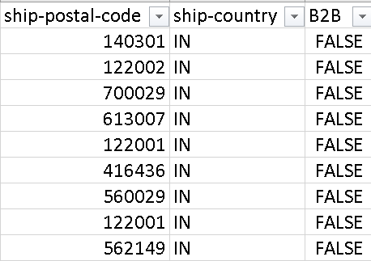
Data &Columns Names Rows:31048, Columns:21

Slide 5
Questions?
Q.1 Compare the Sales and orders using single chart?
Q.2 Which month got the Highest Sales and order
Q.3 Who purchased more men or women?
Q.4 Different Order Status?
Q.5 List Top 5 States contributing to the sales?
Q.6 Which Channel is contributing maximum sales?
Q.7 Relationship Between age & Gender based on number of orders?

Slide 6
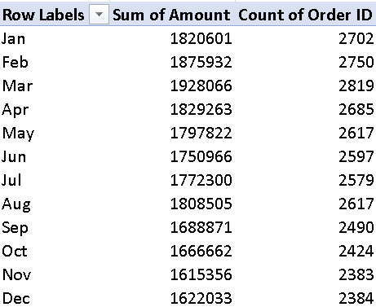
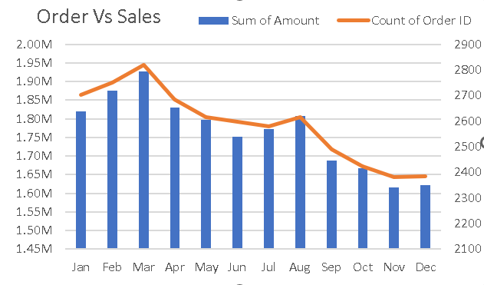
Month Wise Sales &Orders

Slide 7
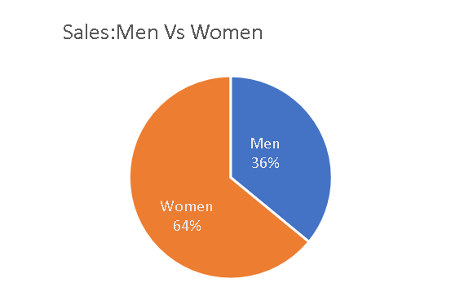

Sales : Men Vs Women

Slide 8
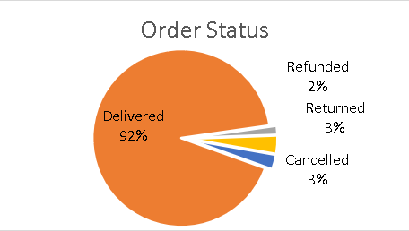
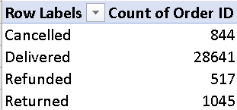
Order Status

Slide 9
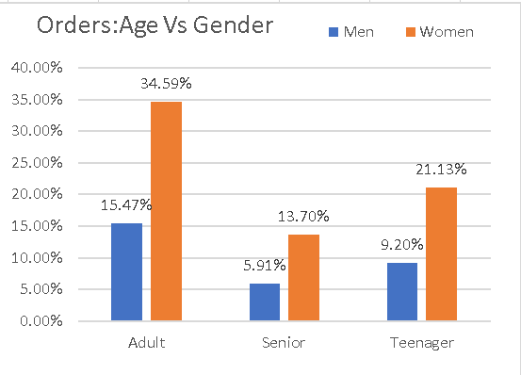
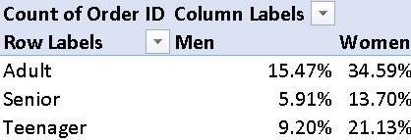
Order : Age Vs Gender

Slide 10
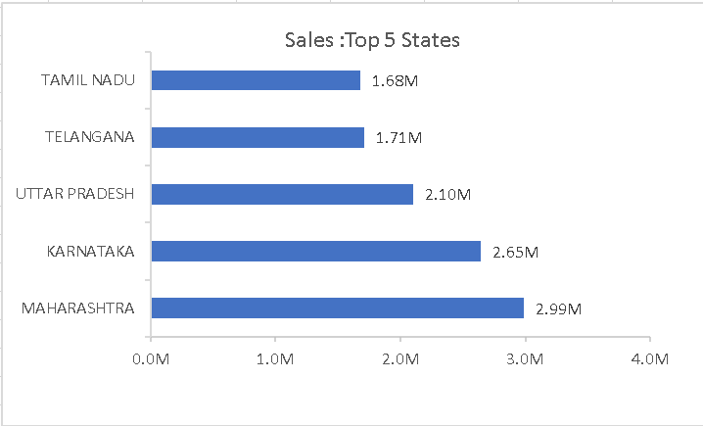
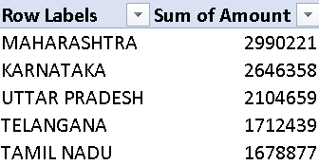
Sales: Top 5 States

Slide 11
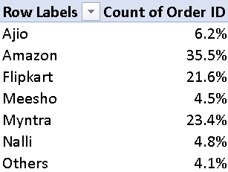
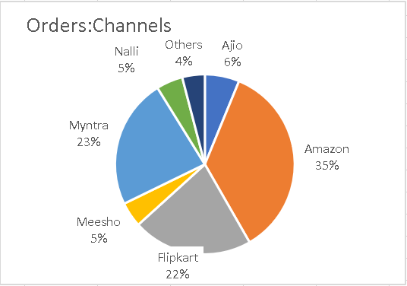
Sales : Channel Wise

Slide 12
SAMPLE INSIGHTS
Women are more likely to buy compared to men(~65%)
Maharashta,Karnataka and Uttar Pradesh are the top 3 States(~35%)
Adult age group(30-49 yrs) is max contribution(~50%)
Amazon,Flipkaer and Myntra Channels are max contribution(~80%)
Final Conclusion to improve Vrinda Store Sales
Target Women Customer pf age group (30-49yrs)living in Maharashta , Karnataka and Uttar Pradesh by showing ads/offers/coupons available on Amazon , Flipkart, and Myntra and Flipkart

Slide 13
THANK YOU

